Slide 1


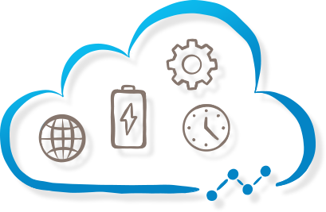




Hearing health care in the 21st century: hearing instruments in the age of connectivity
Stefan Launer, PhD
Senior VP Science & Technology, Sonova AG, Switzerland
Adjunct Professor University of Queensland, Brisbane, Australia
Adjunct Professor University of Manchester, Manchester, UK
Notes:
The role of hearing in daily life:
The social sense, the emotional sense, the monitoring sense
Hearing loss – impact on quality of life (beyond speech intelligibility)
Increased listening effort & fatigue
EMA study BAT
Social isolation, lonliness, depression, …
Reduced ability to socially interact – limited ability to identify affective speech correctly
Hearing instruments improve quality of life beyond speech intelligibiligy
Reduce listening effort ⬄ BVST, Erin Picou’s work, reduced fatigue (Brent, Ben’s work)
Reduced risk of depression
Overall improved quality of life -> Eurotrack, study R McArdle, T Chisholm
Hearing loss, wellbeing, healthy aging – expanding the scope
Audiology – Tinnitus
Cognition & psycho-social functioning: cognitive decline, depression,
Physical health – balance, motion, risk of falls
Systemic health conditions: diabetes, cardio-vascular, hypertensio:
Impact on audiological practice
Offer more audiological services -> Tinnitus, Balance, pediatrics …
Collaborate with other health care parctitioners (lead gen)
Hearing instruments – health monitoring devices?
Integration of other sensors into hearing instruments for health and vital sign monitoring

Slide 2
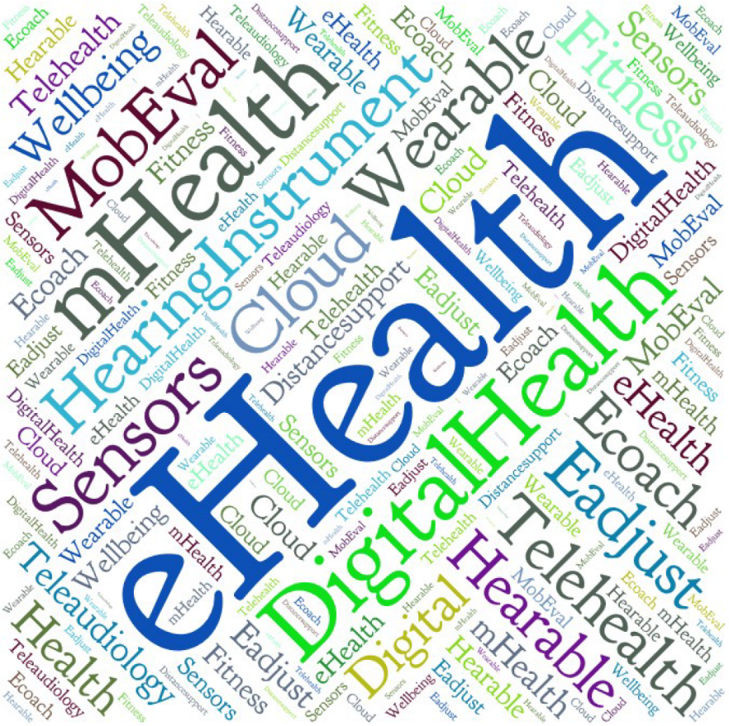
Content
Hearing instrument technology
Connectivity - additional features for improving service delivery
Big Data
Summary

Slide 3
Life is ON-line
Hearing instrument Technology
1

Slide 4
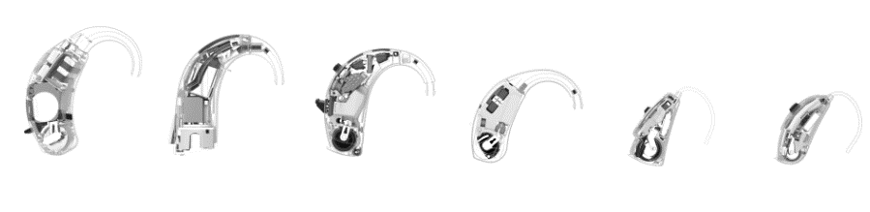
Product Architecture – Miniturization paradoxon!
Many colors and designs available

Slide 5
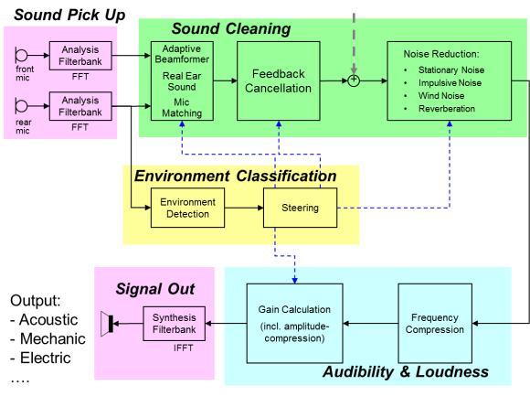
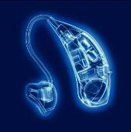
Portfolio of algorithms
- Very low delay of audio signal acceptable (Mic -> loudspeaker): < 10 ms
… a portfolio of solutions for different listening and communication situations.

Slide 6
Hearing instruments – Life is ONline
Portfolio of solutions for different listening conditions – smart automatic control
Always «on»
Additional functionalities: headset, online transcription and translation
New ways of interacting

Slide 7
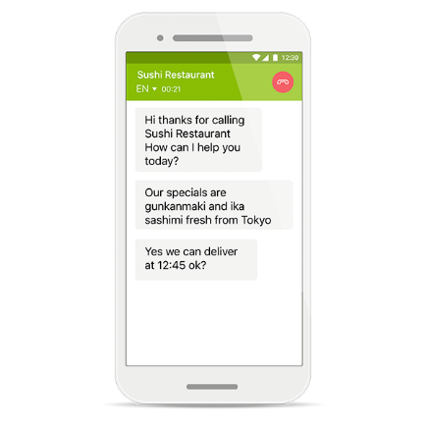

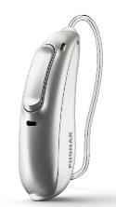



Hearing instruments as communication headsets
Phone call to any mobile, office or fixed line telephone, and even the voice mailbox.
Transcription service converts the voice to text in real time.
HI hands-free calling solutions, users can hear the conversation whilst looking
at the text.

Slide 8
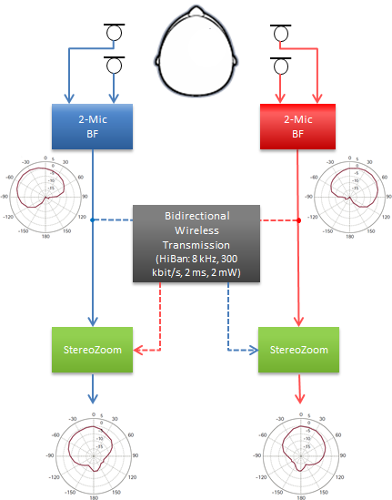
Hearing performance
Speech in adverse conditions ⬄ broad offering for various listening environments – today we include
Enhance existing portfolio of solutions – dynamics! Speaker tracking…
  Amplification scheme for improved sound quality and natural hearing,
  improved perception of soft speech, improved directional microphone (Binaural Loco)
  Improve performance of devices in dynamic spatial listening environments
  Improve perception of affective sounds
Outcome assessment – ongoing
  New test dimensions – listening effort, memory, cognition, behavioral change
  «Well-hearing» is well-being – put hearing loss in context of broader health considerations

Slide 9
Hearing loss – impact on quality of life
Perception of environmental sounds
Cognitive function & decline
Impact on familiy
Depression?
Hearing loss
Ability to communicate
Increased effort & fatigue
Social withdrawl & lonliness
Impact on quality of life
Emotion perception
Emotional functioning & vitality
Ability to learn, work,
Hearing-well ⬄ being-well

Slide 10
Put hearing instruments in a different context
Well-Hearing
is
Well-Being™

Slide 11
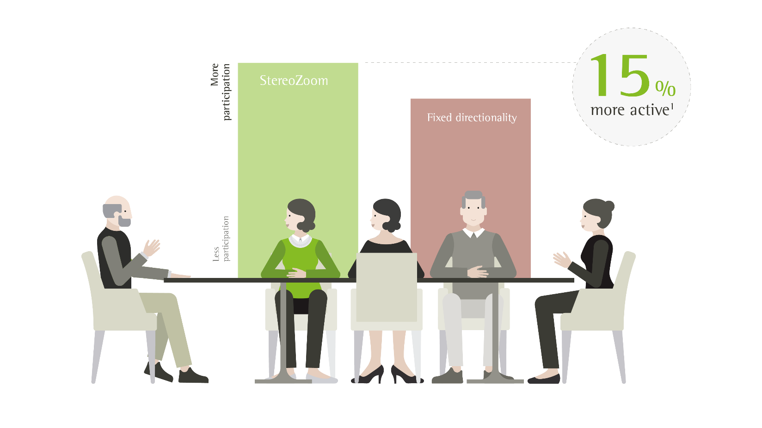
Active participation in social settings
Schulte, M., Meis, M., Krüger, M., Latzel, M., & Appleton-Huber, J. (2018). Significant increase in the amount of social interaction when using StereoZoom. Phonak Field Study News, retrieved from www.phonakpro.com/evidence, accessed October 3rd, 2018.

Slide 12
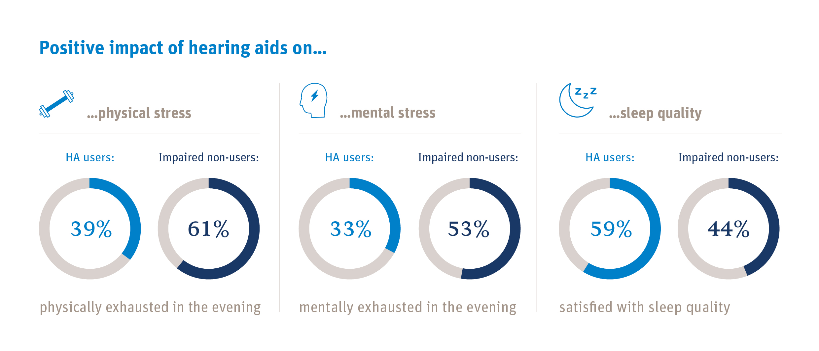
Hearing Instruments – impact on quality of life – EHIMA, EuroTrack 2019

Slide 13

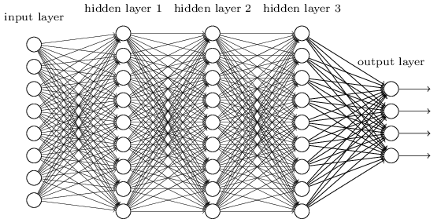
Artificial Intelligence

Slide 14
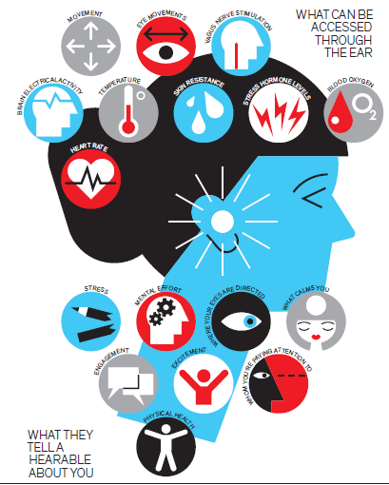

Poppy Crum, Dolby, IEEE Spectrum, May 2019

Slide 15
Service delivery process
3

Slide 16
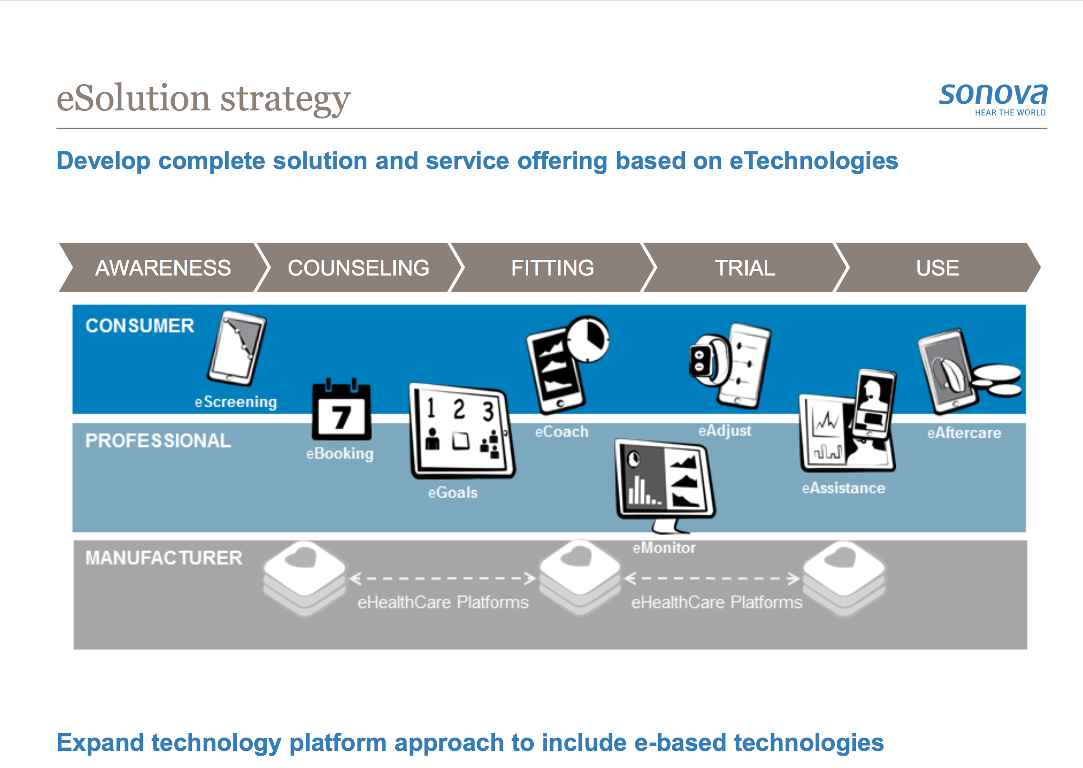

E-Audiology: new approaches to better serve the client along the entire journey
I’m aware…
eCoach/eAssistance
Trial
eFitting
Fitting to individual needs
eAssessment
eScreener
Consumer assessment
New models of service delivery – blended models, self-empowered - Risk or opportunity for our profession?
OPPORTUNITY to improve service delivery in hearing health and audiological care!

Slide 17
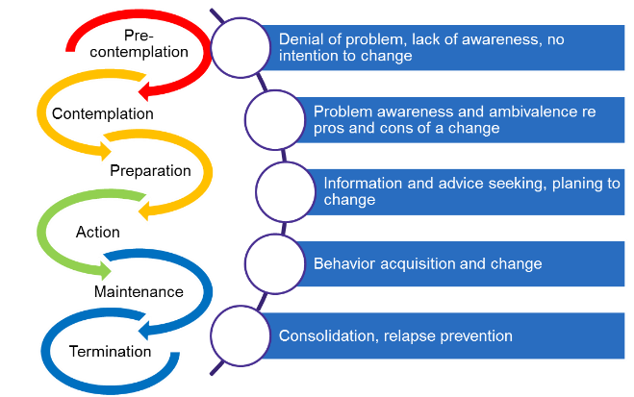
Hearing loss: gradual decline
AWARENESS
COUNSEL
FITTING
TRIAL
USE
Hearing impaired often do not realize what they are missing out on
  Family members realize first…
Nearly 10 years from first realization to action
(Simpson, Dubno et al 2018, Ear & Hearing)
How can we motivate people to take action earlier?
Social support, family centered care

Slide 18
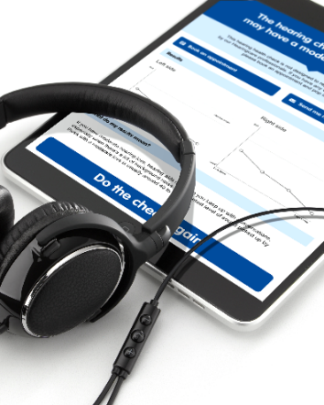
Online screening
Two staged process: online screening audiogram and questionnaire
Boots Hearing Care:
up to today about 190’000 e-Hearing Checks completed online, 13’000 booked an appointment
                - 20% of customers surveyed said they would not have booked in store otherwise
Evaluation of precision of screening
Attracting a younger customer demographic (average age 55-60 compared to 65-70 in the clinic)

Slide 19
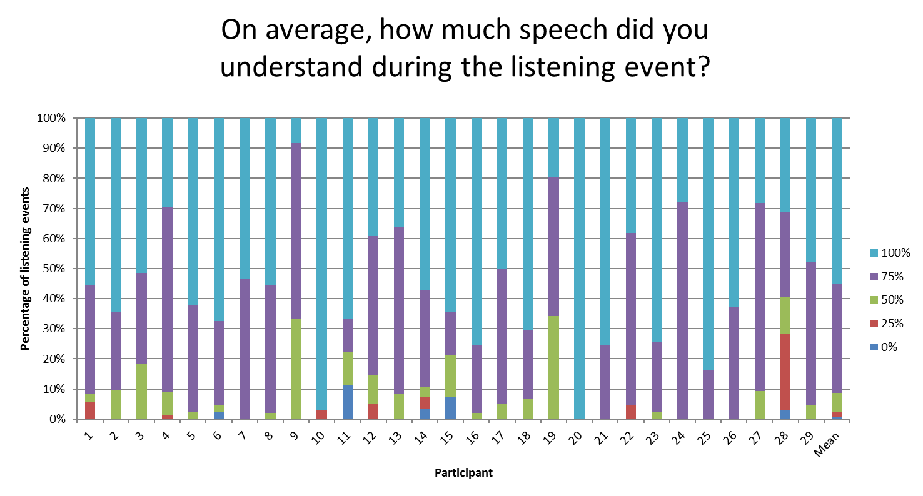
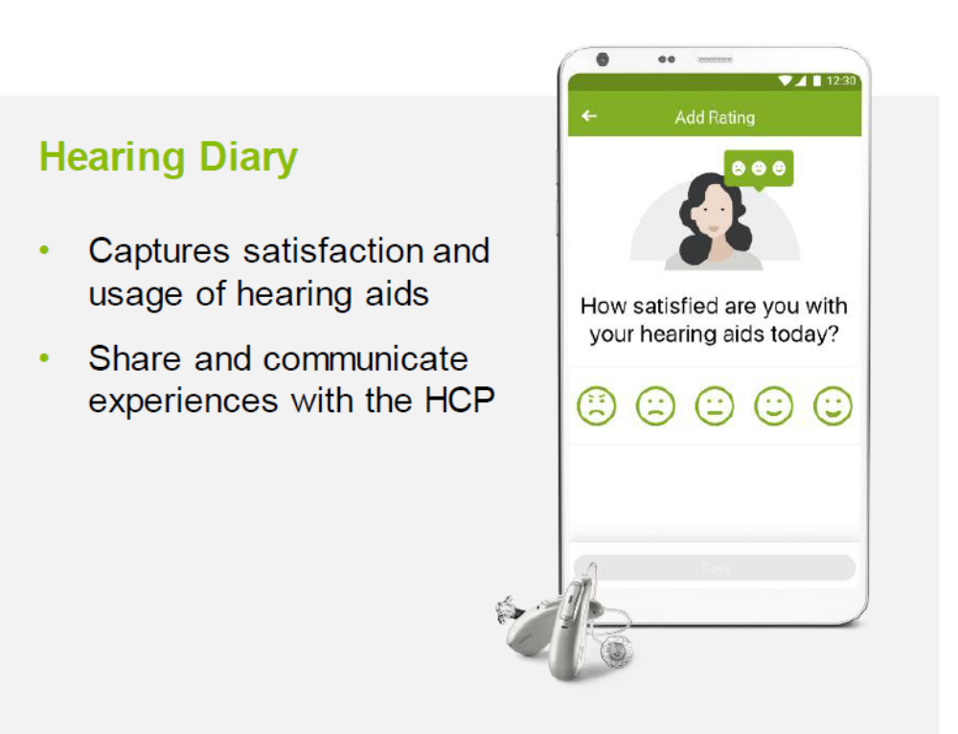
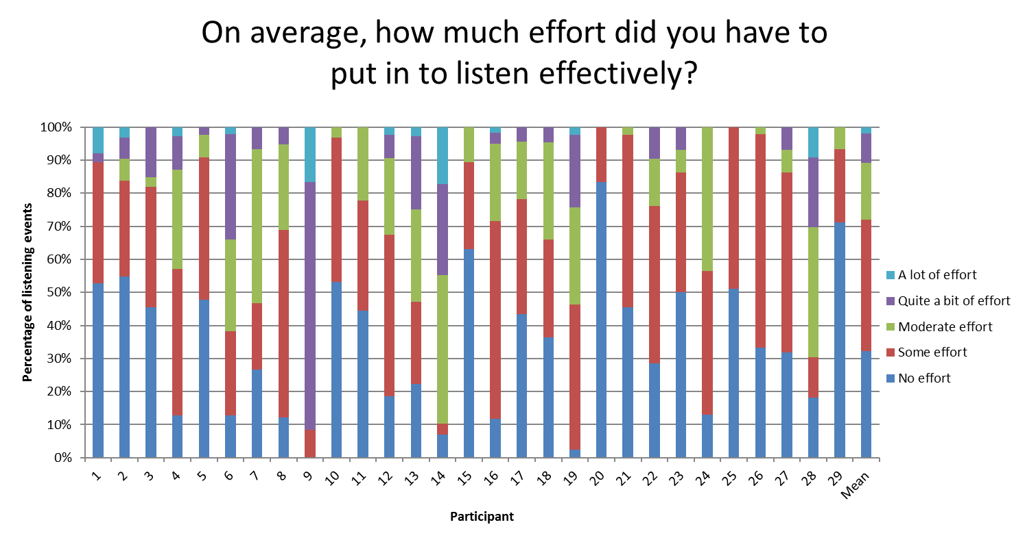
Ecologic Momentary Assessment
Timmer, B. H. B., Hickson, L., & Launer, S. (2018).
Trends in Hearing & Hearing Research

Slide 20
Distance support
User
HCP
2.4 Direct
Real-time

Slide 21
Big data – learning ….
4

Slide 22
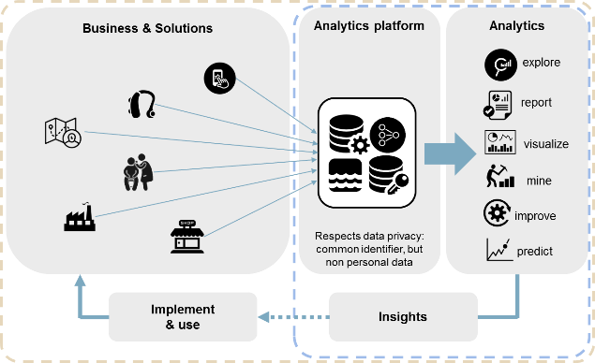
Big Data – learn and predict
Consumer / Patient Journey - profile
Information about the usage of our solutions & services (HW&SW)
Channel, shop & process efficiency:
audiological aspects
Channel, shop & process efficiency:
business aspects
Comorbidities:
Hearing loss in the context of other health considerations

Slide 23
Usage time of hearing instruments – 650’000 people
July 2019, 650’000 fittings

Slide 24
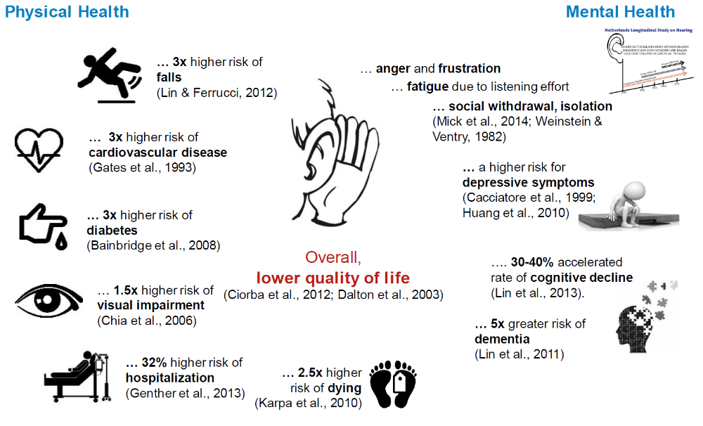
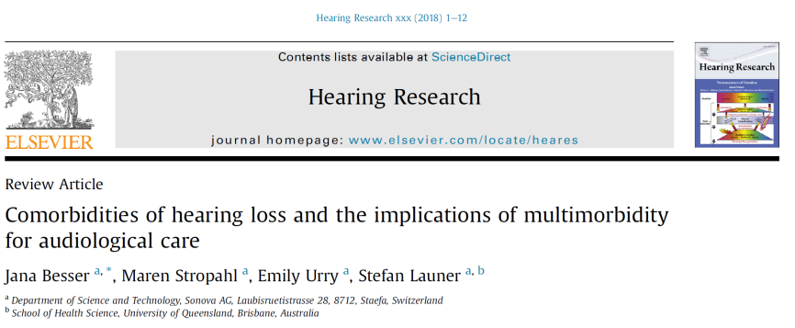
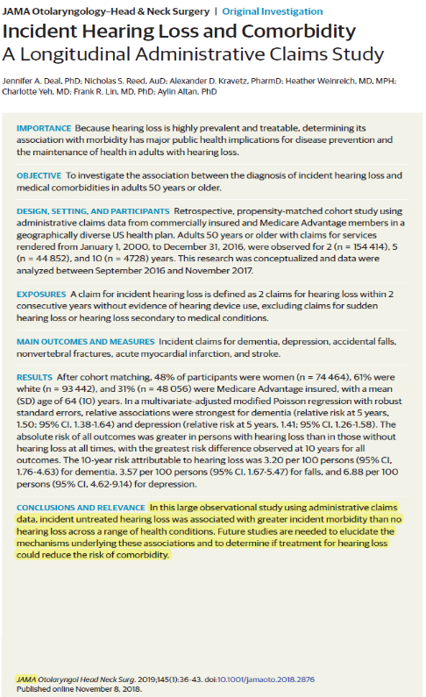
Hearing loss and comorbidities

Slide 25
Hearing loss and comorbidities
300’000 customers (50’000 shops x 6 appointment)
Among which…
>210’000 have a Cardio Vascular Disease
>90’000 will fall at least once within a year
>90’000 have Diabetes
30’000 have Alzheimer
And all we do is ask «how is your hair cell doing today?»

Slide 26
Summary
5

Slide 27
Summary
Hearing instruments transform to «Hearables»
Put hearing loss in a different context ⬄ «well-hearing is well-being»
Hearing loss and healthy living ⬄ interprofessionalism
Hearing care in the context of broader audiological care

Slide 28
Summary
Increase adoption of hearing systems
Understand individual needs
Family centered care
Offer new services
Tinnitus
Balance & vestibular
Interprofes-sionalissm
Geriatricians
Pediatric communication disorders
Various specializations
Change narrative about hearing loss
Network with other health care providers
GPs
Hearing instruments
⬄ Hearables

Slide 29
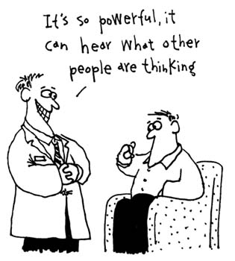
Thanks!

